Slide 1
Integrating Nagios with
Test Driven Development
Integrating Nagios with
Test Driven Development
Nathan Vonnahme
Nathan.Vonnahme@bannerhealth.com

Slide 2
Intro
9 years of hospital IT
Developer -> sysadmin
Sysadmin -> developer

Slide 3
Central Idea
Monitoring tools are to the sysadmin what testing tools are to the developer.
Notes:
Maybe obvious… stepping back a bit to consider the theory and inspire you to use Nagios to improve the quality of your service.

Slide 4

Blog post
goo.gl/Oc2rn
CASE sensitive!

Slide 5
Overview
Test-driven Development
Monitoring and TDD
Sample tools
Further ideas/implications
Notes:
Write this on a board?

Slide 6
I. Test-driven Development (TDD)
Notes:
A quick review, for people who’ve been

Slide 7

Kwalitee Uhshuranse (QA)
What is “quality”?
  “In its broadest sense, quality is a degree of excellence: the extent to which something is fit for its purpose. In the narrow sense, product or service quality is defined as conformance with requirement, freedom from defects or contamination, or simply a degree of customer satisfaction.”
Notes:
source: "Introduction to Quality" from the UK's Institute of Quality Assurance http://www.iqa.org/information/d2-1.shtml

Slide 8

Quality is a result
“Quality is the result of a comparison between what was required and what was provided. It is judged not by the producer but by the receiver.”

Slide 9
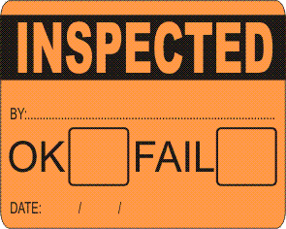
How do you get quality?
By, among other things:
  verifying before delivery that products and services possess the features required
  preventing the supply of products and services which possess features which dissatisfy customers

Slide 10

Testing
Ensures essential function
Catches defects

Slide 11
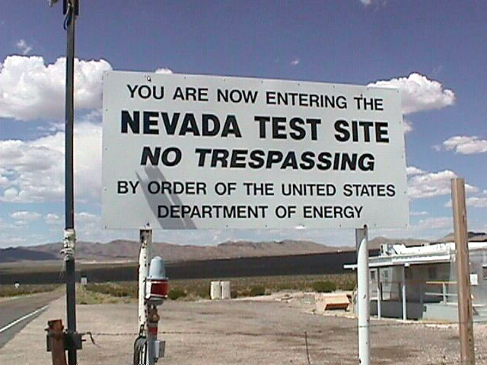
Software Testing Types
(Names/categories vary)
Unit
Integration
User Acceptance
Notes:
In order of abstraction. Unit tests are low-level; acceptance tests high level.

Slide 12

1. Unit testing
Does each individual piece do what we expect?
Yes or no?

Slide 13
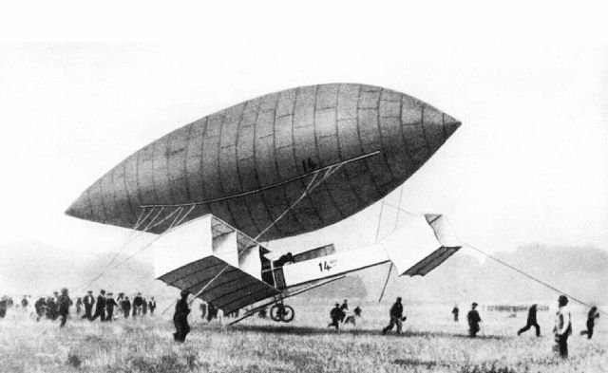
2. Integration testing
Do the units work together?
We need a parallel universe!

Slide 14
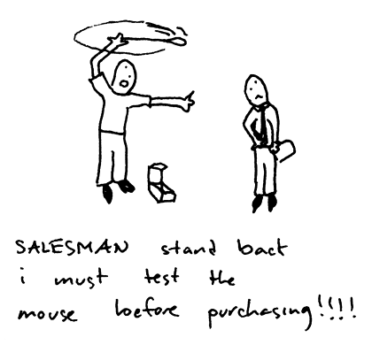
3. User Acceptance testing
AKA “Functional testing” or “Customer testing”
Does it work for the actual user?
Does it do what we promised?
“User stories”
  As a user closing the application,
  I want to be prompted to save anything that has changed since the last save
  so that I can preserve useful work and discard erroneous work.

Slide 15

Test Automation
The robots will do our work for us!

Slide 16
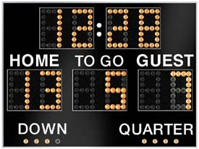
Why automate?
Thorough
Consistent
Fast
More likely to actually get run
Running scoreboard
  “us 43 them 0”

Slide 17
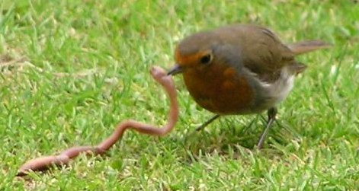
TDD (~1999)
Testing is such a good idea, let’s do it
  Early (test first, then implement)
  Always (test automation)
  Often (continuous integration)

Slide 18

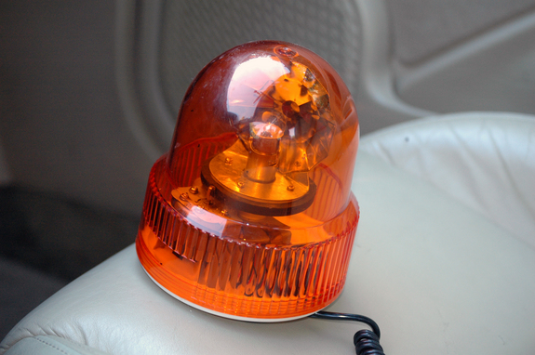

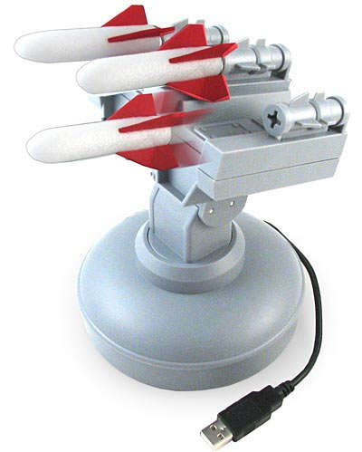
Continuous Integration
Run the test suite whenever source code changes!
Alarm if any tests fail!

Slide 19
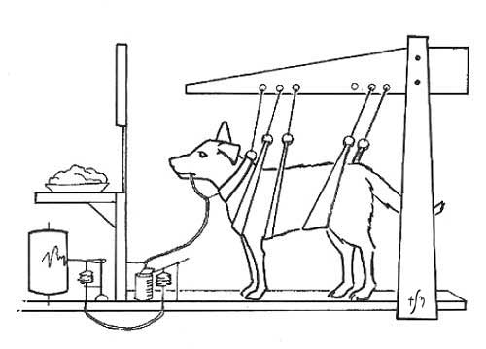
Behavior-driven development (~2003)
BDD builds on TDD but especially emphasizes acceptance testing, and begins by writing user stories, not unit tests.
Notes:
E.g. not “Does the Adder object add numbers properly?” but “Can the cashier complete a sale?”

Slide 20
II. Monitoring and TDD

Slide 21
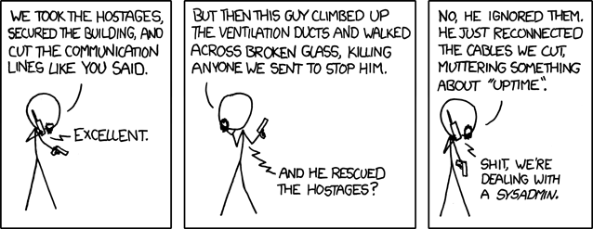
Monitoring as TDD
At the highest level, monitoring is QA.
Notes:
We’re all trying to deliver quality. XKCD mouseover text: “The weird sense of duty really good sysadmins have can border on the sociopathic, but it's nice to know that it stands between the forces of darkness and your cat blog's servers.”

Slide 22
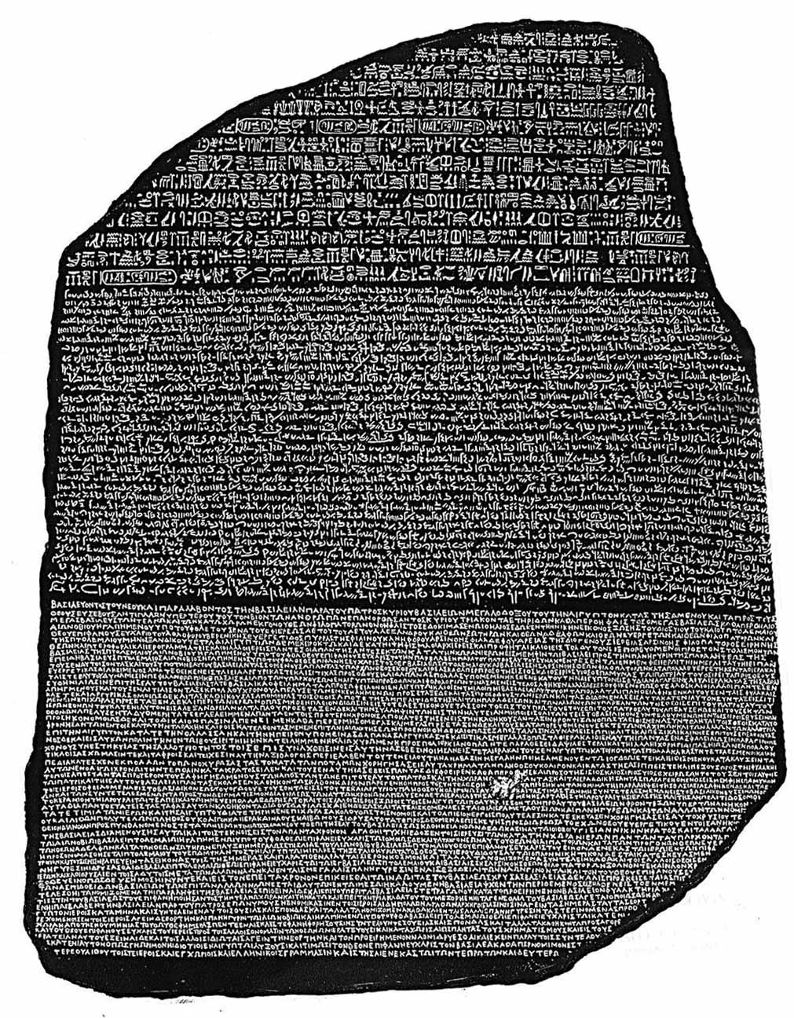
Translation needed
How do these types of testing
translate for the sysadmin?
Unit
Integration
Acceptance

Slide 23
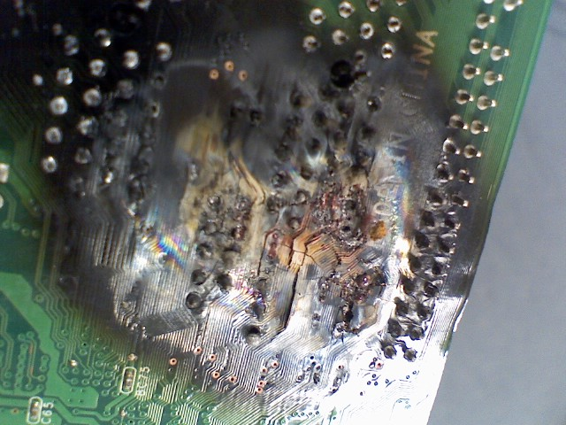
Unit
Hosts pingable
Filesystems writable
CPU, memory properly utilized
OS functioning
Services running
Notes:
We certainly need to monitor these things! They particularly speed problem resolution.

Slide 24
Unit Monitoring with Nagios
Many plugins for “unit” monitoring:
check_ping
check_swap
check_load
check_disk
check_dhcp
check_http
check_ldap
check_mysql
check_nt
check_ntp_peer
check_pgsql
check_procs
check_radius
check_smtp
check_ssh

Slide 25
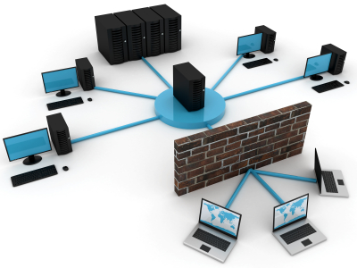
Integration
Cross-machine functions
Database queryable
Data fresh
Expected scheduled processes have completed
Backups worked
Printing works

Slide 26
Integration Monitoring with Nagios
A few plugins for “integration” monitoring:
check_mysql_query
check_hpjd ?
Usually requires custom plugins. Some of mine:
check_backup
check_printer
check_app_logins
check_chartserver*
*See my other talk.
Notes:
*See my other talk.

Slide 27

User Acceptance
Required functions
Acceptable speed
Expected security/access
Core expectations
  Homepage isn’t defaced
  User can log in
  Customer can buy stuff

Slide 28


User Acceptance Monitoring with Nagios
Maybe some with check_http.

Slide 29

Growing Test Coverage
Mark Jason Dominus:
Start by saying "I'll write one [Nagios check]".
You don't have to write all the
[Nagios checks] before you start
the project.

Slide 30

Test Bugs
“When you fix (or find) a bug, add a [Nagios check] for it”
  You’ll fix it much faster next time
  For serious repeating issues, add an event handler!

Slide 31

Test Features
“When you add a feature, add a [Nagios check] for just that feature”
A new service
A new piece of
hardware

Slide 32
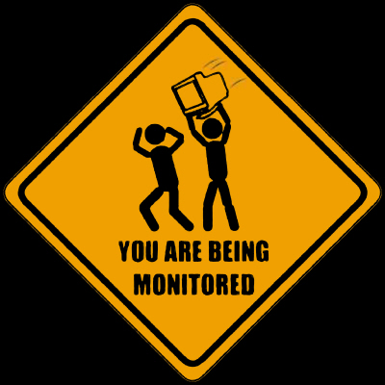
Test Sysadmins
That thing you always forget to turn back on
That task you always procrastinate (SSL cert expiry?)
That filesystem that doesn’t always mount
That long process you forget to verify (backups, anyone?)
Random and senseless acts of system administration

Slide 33

Test Users
“Login is slow!!!”
How slow?

Slide 34
III. Sample Tools for Nagios
Reusing software testing tools for monitoring

Slide 35


TAP – Test Anything Protocol
Testanything.org
Notes:
e.g. PHPUnit can produce TAP output. See http://testanything.org/wiki/index.php/TAP_Producers

Slide 36
TAP – Test Anything Protocol
Widespread for Perl, many others
Simple output (kind of like Nagios plugins)
1..4
ok 1 - Input file opened
not ok 2 - First line of the input valid
ok 3 - Read the rest of the file
not ok 4 - Summarized correctly

Slide 37
TAP is widely used for Perl unit tests
The core Perl language has over 92,000 tests
There are over 142,000 tests for the libraries bundled with it.
Whenever you install a CPAN module:
  t/check_stuff.t ................... ok
  t/Nagios-Plugin-01.t .............. ok
  t/Nagios-Plugin-02.t .............. ok
  t/Nagios-Plugin-03.t .............. ok
  t/Nagios-Plugin-04.t .............. Ok
  t/Nagios-Plugin-Functions-01.t .... ok
  t/Nagios-Plugin-Functions-02.t .... Ok
  . . .
  All tests successful.
  Files=16, Tests=971, 5 wallclock secs ( 0.21 usr 0.07 sys + 4.27 cusr 0.42 csys = 4.97 CPU)
  Result: PASS
Notes:
http://www.perl.org/about/whitepapers/perl-testing.html

Slide 38

TAP producer example
Writing test scripts is super easy.
#!/usr/bin/perl -w
use Test::Simple tests => 1;
ok( 1 + 1 == 2 );
Other languages likewise.
Start (with Perl) by reading Test::Tutorial.
goo.gl/7C7pb

Slide 39
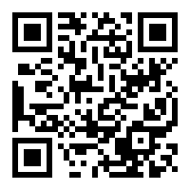
check_tap.pl
Explained in blog. Available at goo.gl/j8Xt2
check_tap.pl -s /full/path/to/testfoo.pl
will run ‘testfoo.pl’ and return OK if 0 tests fail, but CRITICAL if any fail.
check_tap.pl -s /full/path/to/testfoo.pl -c 2
will return OK if 0 tests fail, WARNING if more than 0 tests fail, and CRITICAL if more than 2 fail.

Slide 40
check_tap.pl
Non-Perl and remote test scripts
check_tap.pl -e '/usr/bin/ruby -w' -s /full/path/to/testfoo.r
will run ‘testfoo.r’ using Ruby with the -w flag.
You can use any shell command and argument which produces TAP output, for example:
check_tap.pl -e '/usr/bin/curl -sk' -s 'http://url/to/mytest.php'
check_tap.pl -e '/usr/bin/cat' -s '/path/to/testoutput.tap'
In fact, anything TAP::Harness or prove regards as a source or executable.

Slide 41
Ex. 1: firewall ports
use Test::Ping; # written by NJV 2005; not from CPAN
plan tests => 13;
ping_ok(qw~ localhost http ~);
ping_ok(qw~ localhost https ~);
diag "app server internal_server";
ping_ok('internal_server.my.com', 'http');
service_ok('internal_server.my.com', 'http');
ping_ok('internal_server.my.com', 'https');
service_ok('internal_server.my.com', 'https');
ping_ok('internal_server.my.com', '1433', ‘internal_server pingable on MS SQL port 1433');
service_ok('internal_server.my.com', '1433‘, ‘mssql responds’);
ping_ok('internal_server.my.com', '3306', ‘internal_server pingable on MySQL port 3306');
service_ok('internal_server.my.com', '3306‘, ‘mysql responds’);
diag "testing open ports to other inside hosts\n";
service_ok( 'smtp.my.com', 'smtp', "can contact smtp (email) service on smtp.my.com");

Slide 42
Ex. 1: firewall ports – OUTPUT
1..13
ok 1 - this script is running on (xxx) the physician portal webserver
ok 2 - can connect to localhost:http
ok 3 - can connect to localhost:https
# app server internal_server
ok 4 - can connect to internal_server.my.com:http
ok 5 - service is answering on internal_server.my.com:http
ok 6 - can connect to internal_server.my.com:https
ok 7 - service is answering on internal_server.my.com:https
ok 8 - can contact internal_server (web app server) on MS SQL port 1433
ok 9 - service is answering on internal_server.my.com:1433
ok 10 - can contact internal_server (web app server) on MySQL port 3306
ok 11 - service is answering on internal_server.my.com:3306
# testing open ports to other inside hosts
ok 12 - can contact smtp (email) service on smtp.my.com
ok 13 - Survived to end
Check command:
check_tap.pl -v -e '/usr/bin/curl -sk' -s https://$HOSTADDRESS$/foo/porttest.pl

Slide 43
Ex. 2: farm
plan tests => 29;
# test thyself!
my $me = hostname;
like($me, qr/^portal/,
"this script is running on ($me) a physician portal webserver");
diag "checking citrix farm connectivity\n";
my @stas = qw(
vcitrixdc01.my.com
vcitrixdc02.my.com
);
foreach (@stas) {
ping_ok($_, 'http');
service_ok($_, 'http', "XML service on $_ is responding in some way" );
}
my @citrix_farm = qw(
citrixps01.my.com
citrixps02.my.com
# ...
citrixps30.my.com
);
foreach (@stas, @citrix_farm) {
service_ok($_, '1494', "ICA service on $_ is responding in some way" );
}

Slide 44
Ex. 2 OUTPUT
1..29
ok 1 - this script is running on (xxx) a physician portal webserver
# checking citrix farm connectivity
ok 2 - can connect to vcitrixdc01.my.com:http
ok 3 - XML service on vcitrixdc01.my.com is responding in some way
ok 4 - can connect to vcitrixdc02.my.com:http
ok 5 - XML service on vcitrixdc02.my.com is responding in some way
ok 6 - ICA service on vcitrixdc01.my.com is responding in some way
# ...
ok 13 - ICA service on citrixps06.my.com is responding in some way
not ok 14 - ICA service on citrixps07.my.com is responding in some way
# Failed test (c:\inetpub\wwwroot\pp_nagios\check_citrix.pl at line 80)
# ...
# Looks like you failed 1 tests of 29.
Check command:
check_tap.pl -v -e '/usr/bin/curl -sk'
-s https://$HOSTADDRESS$/foo/porttest.pl -w 3 -c 6
TAP OK - FAIL. 1 of 29 failed. Warning/critical at 2/3. 1st='not ok 14 - ICA service on citrixps07.my.com is responding in some way' | total=29;; failures=1;; passed=28;;

Slide 45

Ex. 3 Symfony2 Functional tests
Symfony2 == next-generation MVC framework for PHP apps
Symfony2 uses the PHPUnit framework.
PHPUnit supports TAP output.
Good developers are already writing these.

Slide 46
Ex. 3 Symfony2 functional tests
public function testSearch() {
$client = $this->createClient();
$crawler = $client->request('GET', '/');
$this->assertTrue($client->getResponse()
->isSuccessful());
$form = $crawler->selectButton('Search')->form();
$form['q'] = 'chest pain';
$crawler = $client->submit($form);
$this->assertTrue($client->getResponse()
->isSuccessful());
$this->assertTrue($crawler->filter('h3')
->count() > 0);
}

Slide 47
Ex. 3 Symfony2 functional tests
$ phpunit.bat --tap -c app src/BHS/.../DefaultControllerTest.php
TAP version 13
ok 1 - BHS\...\DefaultControllerTest::testIndex
ok 2 - BHS\...\DefaultControllerTest::testSearch
ok 3 - BHS\...\DefaultControllerTest::testCareset
1..3

Slide 48
Ex. 3 Symfony2 functional tests
$ perl check_tap.pl -e 'c:/xampp/php/phpunit.bat --tap -c c:/web/cpoe_ordersets/app' -s 'c:/web/cpoe_ordersets/src/BHS/CPOEBundle/Tests/Controller/DefaultControllerTest.php'
TAP OK - PASS | total=3;; failures=0;; passed=3;;

Slide 49



Cucumber
cukes.info

Slide 50

cucumber-nagios
From the Ruby on Rails community.
Thanks to Ranjib Dey for mentioning it to me!

Slide 51
cucumber-nagios
Cucumber is for BDD in “natural” language:
Feature: google.com
It should be up
And I should be able to search for things
Scenario: Searching for things
When I go to "http://www.google.com.au/"
And I fill in "q" with "wikipedia"
And I press "Google Search"
Then I should see "www.wikipedia.org"

Slide 52
cucumber-nagios
cucumber-nagios hooks Nagios up to these features:
$ bin/cucumber-nagios features/ebay.com.au/bidding.feature
CUCUMBER OK - Critical: 0, Warning: 0, 4 okay

Slide 53
IV. Ideas/implications

Slide 54
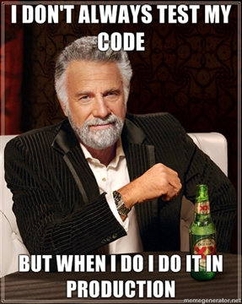

Test in production
Your software came with tests, right?
Can you get them?
Can you write them?

Slide 55

Monitor in development
Build confidence
Leverage Nagios’ strengths
  Not a CI tool but:
  Alerting rules
  Escalation
  Service handlers

Slide 56
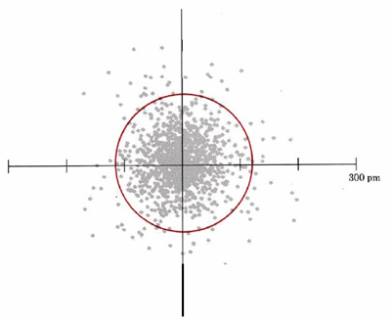
Tolerate ambiguity
How much failure is worth being paged in the middle of the night?
Example: Our Citrix farm

Slide 57

Check from both sides
I can use our web app; can the user?
Firewalls need asymmetrical testing

Slide 58

Monitoring at a higher level
Measure and monitor the things the user sees/feels

Slide 59



Monitoring at a higher level
Selenium tests web apps using actual browsers
AutoIt, AppleScript for GUI apps?

Slide 60

Monitoring at a higher level
Testing mobile platforms is still hard

Slide 61
CENTRAL IDEA
Monitoring tools are to the sysadmin what testing tools are to the developer.

Slide 62
Takeaways
Pursue quality
Learn from software engineering test practices
Monitor at multiple levels
  Unit
  Integration
  Acceptance
Grow your monitoring suite gradually
Re-use testing tools for monitoring

Slide 63
Blatant plug
Come to my other talk at 4:30!
Writing Custom Nagios Plugins In Perl
A hands-on workshop walking you through writing your first custom check script in Perl using the Nagios::Plugin toolkit. Basic familiarity with Perl, Ruby, PHP, or shell scripting would help, but the basic concepts will be transferable to other languages.

Slide 64
Questions?
Comments?
Comments optional at my blog post:
goo.gl/Oc2rn
Notes:
(Plug my other talk)

Slide 65
Bonus Section

Slide 66

Bad restaurant
Customer drinks water
Customer gets thirsty
Notices water glass is empty
Waits
Gets mad

Slide 67

Bad restaurant
Flags waiter (waiter rolls eyes)
Waiter opens a support ticket and assigns it to the busser
Busser is
on break

Slide 68
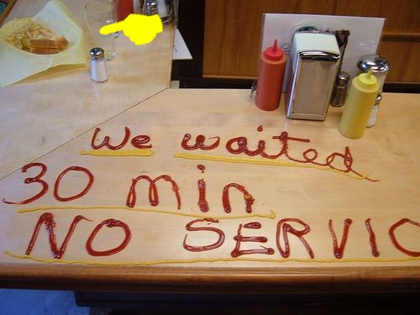
Bad restaurant
Customer waits, flags waiter again
Busser refills water
Customer drinks and leaves a nice big tip

Slide 69

Nice restaurants employ ninja waiters
The customer never notices
but the glass is always full.

